Slide 1
DR.SNSRCAS, CBE
SUBJECT: ADVANCED JAVA PROGRAMMING
COURSE CODE:16UCA502
TITLE: Introduction To Java Servlets
YEAR: V SEMESTER 2022-2023 (ODD)

Slide 2
Introduction To Java Servlets
We define a Java Servlet or Jakarta Servlet as the technology to design and deploy dynamic web pages using the Java Programming Language. It implements a typical servlet in the client-server architecture, and the Servlet lives on the server-side.

Slide 3
There are several varieties of interfaces and classes available in the Servlet API. Some of them are as follows:
HTTP Servlet
Generic Servlet
Servlet Request
Servlet Response

Slide 4
Java Servlet Architecture
We can also consider the software architecture of a servlet as the life cycle of the Java Servlet. To write a Servlet, the user needs first to implement the Servlet Interface, directly or indirectly, using the following import command.
import javax.servlet.*;

Slide 5
Once the Servlet interface is imported, and we inherit the HTTP Class, we begin with the Java Servlet's life cycle.
In the life cycle of a servlet, we have mainly three stages, which are mentioned below.
init()
service()
destroy()

Slide 6
1. init()
The init() is the germinating stage of any Java Servlet. When a URL specific to a particular servlet is triggered, the init() method is invoked.
Another scenario when the init() method gets invoked is when the servers are fired up. With every server starting up, the corresponding servlets also get started, and so does the init() method.

Slide 7
1. init()
One important specialty of the init() method is the init() method only gets invoked once in the entire life cycle of the Servlet, and the init() method will not respond to any of the user's commands.
The init() method Syntax:
public void init() throws ServletException {
init() method initializing
}

Slide 8
2. service()
The service() method is the heart of the life cycle of a Java Servlet. Right after the Servlet's initialization, it encounters the service requests from the client end.
The client may request various services like:
GET
PUT
UPDATE
DELETE

Slide 9
2. service()
The service() method is the heart of the life cycle of a Java Servlet. Right after the Servlet's initialization, it encounters the service requests from the client end.
The client may request various services like:
GET
PUT
UPDATE
DELETE

Slide 10
2. service()
The service() method takes responsibility to check the type of request received from the client and respond accordingly by generating a new thread or a set of threads per the requirement and implementing the operation through the following methods.

Slide 11
2. service()
doGet() for GET
doPut() for PUT
doUpdate() for UPDATE
doDelete() for DELETE

Slide 12
2. service()
The service() method Syntax:
public void service(ServletRequest request, ServletResponse response)
throws ServletException, IOException {
}

Slide 13
2. service()
The service() method Syntax:
public void service(ServletRequest request, ServletResponse response)
throws ServletException, IOException {
}

Slide 14
3. destroy()
Like the init() method, the destroy() method is also called only once in the Java Servlet's entire life cycle.
When the destroy() method is called, the Servlet performs the cleanup activities like,
Halting the current or background threads
Making a recovery list of any related data like cookies to Disk.
After that, the Servlet is badged, ready for the Garbage collector to have it cleared.

Slide 15
3. destroy()
Like the init() method, the destroy() method is also called only once in the Java Servlet's entire life cycle.
When the destroy() method is called, the Servlet performs the cleanup activities like,
Halting the current or background threads
Making a recovery list of any related data like cookies to Disk.
After that, the Servlet is badged, ready for the Garbage collector to have it cleared.

Slide 16
The destroy() method Syntax:
public void destroy() {
//destroy() method finalizing
}

Slide 17
The destroy() method Syntax:
public void destroy() {
//destroy() method finalizing
}

Slide 19
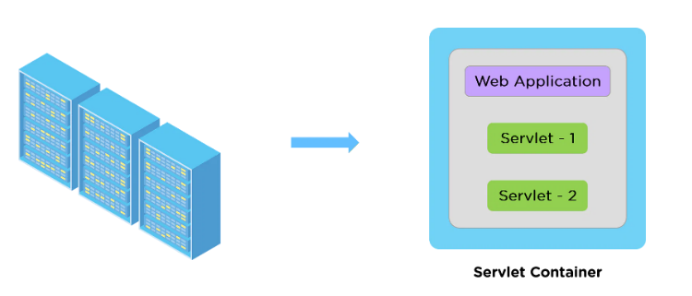

Slide 20
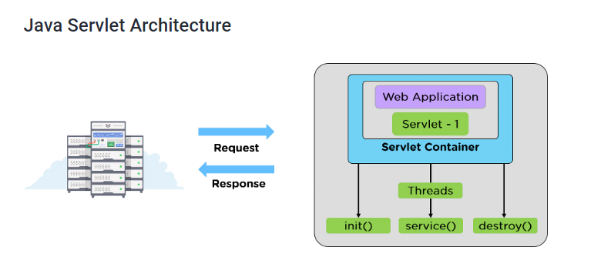

Slide 21
THANK YOU

